Slide 1
French Cooperatives
Context, Project and innovations.

Slide 2
Emergence of cooperatives in France - 1
In 19th century First agricultural cooperative appeared
In 1946, after the war, the state decide to create EDF, to handle all the energetic issues.
In 1999 the energetic producing and providing market got open for high energetic consumer companies ( <100 GW )
1st July 2007 the market extended to everyone including private individuals

Slide 3
Emergence of cooperatives in France - 2
Recently , stating with 3rd august 2016, renewable energy producers are allowed to sell their energy to every certified operator.
Enercoop is the first certified organization.
To sum up, up until 2016 the environment was not suitable for the development of French energetic cooperatives. This caused the delay for the improvement of French energetic cooperatives.=

Slide 4
ENERCOOP
ID card
Created in September 2005.
First and only 100% renewable electricity provider
42 000 consumers
130 Producers
81 MW – Total Power
10 regional cooperatives
Certified operator for buying sustainable energy!
Example of project : In cooperation with Energie Partagée , Enercoop bought a wind farm in from a small town of Loire-Atlantique in order to produce the equivalent consummation of 6900 home in the very same area.

Slide 5
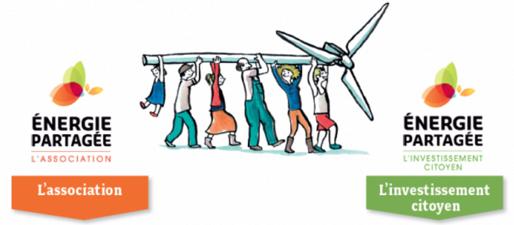
ENERGIE PARTAGEE
ID card
Created in 2010
An association and an investment tool.
32 local project financed
4785 citizen shareholder
12 Millions euros collected
Promote cooperative model.
Advice and support the project promoter.
Keep the network lively.
Raise awareness among local collectivities for the development of new civic energetic policies.
Guarantee the respect of the charter.
Collect fund
Evaluate the project and its financial needs
Provide the fund for the selected project
Follow up the project.
Project example: Atout Vent , after 6 years of studies, fund-raising and a lot of work; 3/5 wind turbine were ready. At the end, the park provided enough electricity for 7100 home.

Slide 6
EPV / I-ENER / Les 7 Vents
EPV was an association, changed it status to cooperative in 2005. The association is the origin of the project Begawatt, that is one of the first idea to create a wind-turbine cooperative park, which involve 4 wind turbine.
i-ENER is a cooperative created in October 2014 because founder realized 99% of energies in the south-west of France were imported. Now, I-Ener either starts or follows up different projects.
Les 7 Vents is created in 1992 as an association, until 2005, then it became a cooperative. Since 1998, 27 000 people have been impacted by the advices of Les 7 vents.

Slide 7
Example of projects - Begawatt
Context
2002 : A couple checks if it’s possible to put a wind turbine in their garden to contribute to the production of renewable energy.
2003 : The association Eolienne en Pays de Vilaine is created with the help of 100 people.
2005 : 2 different places are found.
From 2005 to 2013
1 - Pre-diagnosis..............................................................................................................8 to 12 month
2 - Incorporation of the file of the building permit; impact study, wind study........ 2 to 3 years
3 – Submission of the ask................................................................................................1 to 3 years
4 – Financial arrangement and building......................................................................1 to 2 years
Built : 2014
Park : 4 machines
Providing for 8000 houses
Cost : 12M euros
The outcomes : - Importance of regional investment - Establishment of partnership
- Having a follow up by a human resource dedicated to the project

Slide 8
Example of projects – Luc-Sur-Aude
Context
2004: a few developers ask to the city to develop a photovoltaic park because the exposition was beneficial for the solar panel.
Between 2008 and 2012 the municipality carried the project.
In 2012 after environmental research, the place was finally found.
During this time, seeing the project not moving, the idea of Eco-citizen participation appeared.
In 2015, the region Languedoc-Roussillon call a request for proposal to create a innovative mecasism covering the approach of financial citizen participation and to give 1euros per citizen participating to the project.
In April 2017, 255 000 euros have been collected.
Finish : September 2017
Providing energy for 80 homes
Cost : 350 000 euros
The outcomes : - participation of local authority is really important
- the communication with local people is a must.

Slide 9
INNOVATIONS
Communication :
Brochure adapted like a comic to raise awareness towards renewable energies among people, such in public events.
A film is shot right after an innovation project has finished.
Juridical :
Lobbying at the time of writing of a decree by the state.
Research :
Develop a branch of studies which can help studies financially, with the aim to reduce the risk of failure of a project.
Teaching :
Improving and innovating trainings, for example « how to communicate about citizenship renewable energy project ».

Slide 10
European Window
Rescoop, the European federation of renewable energy cooperatives.
11 European Member States: Belgium, Croatia, Denmark, France, Greece, Italy, Netherlands, Portugal, Spain, United Kingdom and Ireland.
French cooperatives members : Enercoop , Energie Partagée, Jurascic.
The importance of Europe in the development of French cooperatives is crucial.
Having more impact on European energy debate.
Help countries.

Slide 11
Conclusion
The environment that France offered wasn't favorable for the creation of cooperative.
Cooperative had to adapt and the interest of citizen became even more important.
In despite of the difficulty, many project came out.
The importance of European relation and the help between countries increased the quality and rapidity of the development of the projects

